Slide 1
ANATOMY OF THE PROSTATE
BY
DR. OJEWALE A.O

Slide 2
OUTLINE
Intro’
Location
Shape & size
External features & lobes
Structures within & capsules of the prostate
Supports of the prostate
Structure & structural zones of the prostate
Blood supply
Applied anatomy

Slide 3
Intro’
The prostate is a pyramidal-shaped, fibromuscular glandular organ which surrounds the prostatic urethra.
The prostate gland secretes acid phosphatase, fibrinolysin, citric acid, amylase, prostate-specific antigen (PSA), and prostaglandins.
Its secretions form the bulk of the seminal fluid. Its female homologue is paraurethral glands (of Skene)

Slide 4
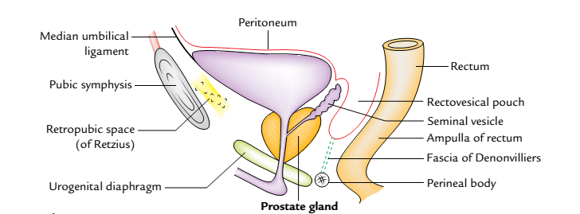
Location
It is located in the lesser pelvis below the neck of the urinary bladder and above the urogenital diaphragm.
It lies behind the lower part of the pubic symphysis and in front of the rectal ampulla. It is embraced on each side by the levator ani muscle.
Location of the prostate gland: as seen in the sagittal section.

Slide 5
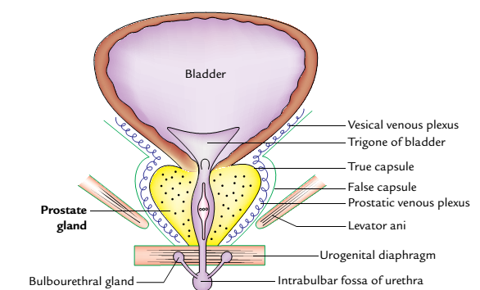
Shape & Size
The prostate is like an inverted cone in shape and resembles a chestnut in appearance. It presents the following measurements:
Weight: 3 g.
Length: 3 cm.
As seen in the coronal section.

Slide 6
External Features and Relations
The prostate presents the following external features:
Apex.
Base.
Four surfaces (anterior, posterior and two inferolateral).
Apex
It is directed downward and rests on the superior surface of the urogenital diaphragm.

Slide 7
Cont’d
Base
It is directed upward and surrounds the neck of the urinary bladder with which it is continuous structurally. The junction is marked by a circular groove. The base is pierced by the urethra in the median plane at the junction of its anterior one-third and posterior two-third.
Surfaces
Anterior surface: It is narrow and convex from side to side. It is situated 2 cm behind the pubis symphysis.

Slide 8
Cont’d
It is separated from the symphysis by the retropubic space (of Retzius) filled with extraperitoneal fat. A little above the apex, this surface is pierced by the urethra.
Posterior surface: It is broad and flat and lies in front of the ampulla of the rectum, from which it is separated by the fascia of Denonvilliers. The posterior surface is divided into small upper and larger lower areas by a transverse sulcus, which is pierced on each side of the median plane by the ejaculatory duct.

Slide 9
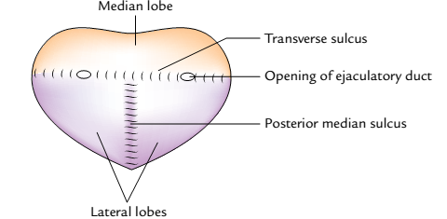
Cont’d
The upper areas represent the median lobe and the lower area is divided by a posterior median sulcus into two lateral lobes.
Inferolateral surfaces: These are related to the anterior fibres of levator ani (levator prostate).
Features of the posterior surface of the prostate

Slide 10
Lobes of the Prostate
The prostate is divided into five lobes:
Anterior lobe (isthmus).
Posterior lobe.
Median lobe.
Two lateral lobes.
Anterior Lobe
The anterior lobe lies in front of the urethra and connects the two lateral lobes. It is devoid of the glandular tissue and often called isthmus.

Slide 11
Cont’d
Posterior Lobe
It lies behind the ejaculatory ducts and median lobe and connects the two lateral lobes. The primary carcinoma of the prostate begins in the posterior lobe.
Median Lobe (Middle Lobe)
It is wedge-shaped and lies behind the upper part of the urethra and in front of ejaculatory ducts. Its base produces an elevation at the apex of trigonum vesicae called uvula vesicae.

Slide 12
Cont’d
The median lobe normally projects into the prostatic urethra raising a ridge called urethral crest. It contains much of the glandular tissue and is a common site of adenoma.
Lateral lobes
It lie one on each side of the urethra. On the posterior surface of the prostate, two lateral lobes are separated from each other by posterior median sulcus. The lateral lobes contain some glandular tissue and therefore adenoma may arise here in the old age.

Slide 13
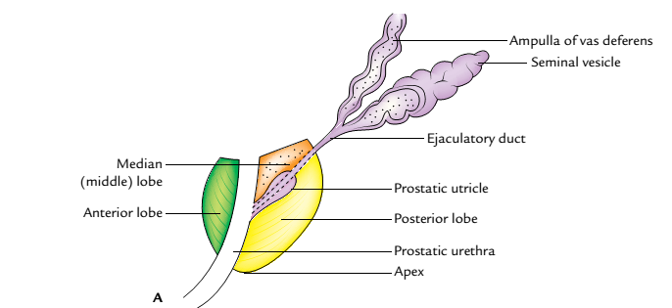
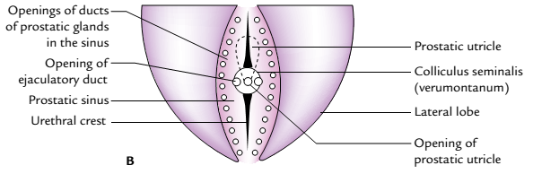
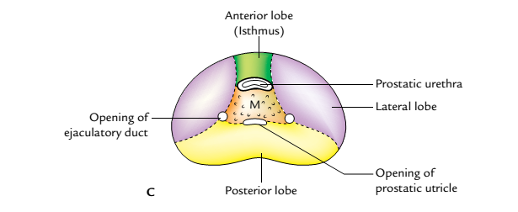
Lobes of the prostate gland as seen in sections through different planes

Slide 14
Structures within the Prostate
Prostatic urethra traverses vertically downward through the gland at the junction of its anterior one-third and posterior two-third and opens on the anterior surface just above the apex.
Ejaculatory ducts traverse the gland posterolateral to the median lobe and open in the urethra.
Prostatic utricle is a mucous cul-de-sac about 6 mm long which extends upward and backward from the prostatic urethra, behind the median lobe.

Slide 15
Capsules of the Prostate
The prostatic capsules are two in number in normal gland and three in number if gland is affected by benign hypertrophy of the prostate.
True capsule: It is formed by the condensation of peripheral fibrous stroma of the gland.
False capsule (prostatic sheath):It is derived from the pelvic fascia. It is outside the true capsule, and envelops the prostate gland and urinary bladder in the same compartment.

Slide 16
Cont’d
Surgical/pathological capsule: When the adenoma of the gland enlarges, the peripheral part of the organ becomes compressed. This compressed part of the gland is called surgical or pathological capsule.
The prostatic venous plexus lies between the true and false capsules except on the posterior surface of the gland.

Slide 17
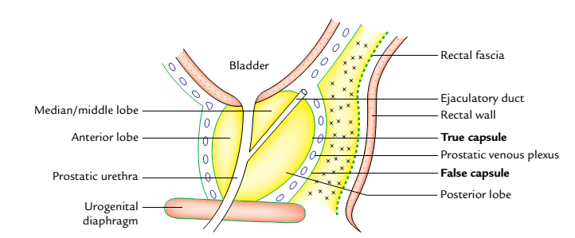
Capsules of the prostate gland as seen in the sagittal section

Slide 18
Supports of the Prostate
Urogenital diaphragm: The apex of the gland rests on it and the prostatic sheath (false capsule) is continuous with its superior fascia.
Two pairs of puboprostatic ligaments: They extend from the prostatic sheath (false capsule) to the back of the pubic bones. The medial pair lies near the apex of the gland and the lateral pair close to the base.
Rectovesical fascia of Denonvilliers: The posterior aspect of prostatic sheath attaches to this fascia posteriorly.

Slide 19
STRUCTURE OF THE PROSTATE
It is made up of fibrous tissue (1/4), muscular tissue (1/4), and glandular tissue (1/2). The glandular tissue consists of tubuloalveolar glands arranged in three concentric groups (mucosal, submucosal, and main); all of them open into the urethra. The fibromuscular tissue forms the stroma and the glandular tissue forms the parenchyma of the prostate gland. The lumen of tubuloalveolar gland contains small colloid masses called corpora amylacea.

Slide 20
Structural zones of the Prostate Gland
There are two well-defined concentric zones separated by an ill-defined irregular fibrous layer. The zones are absent anteriorly.
Outer zone: The larger outer zone is composed of long branching glands (prostatic gland proper). The ducts of these glands curve backward and open in the prostatic sinus below the colliculus seminalis. This zone is the common site of carcinoma prostate.

Slide 21
Cont’d
Inner zone: The smaller inner zone is composed of outer submucosal glands, which open in the prostatic sinus at the level of colliculus seminalis. Deep to these glands are simple mucosal glands (suburethral glands), which are short and open all around the urethra above the level of colliculus seminalis.
All hypertrophies of the prostate arise from these mucosal (suburethral/subcervical) glands. Therefore, the inner zone of prostate is the common site of benign prostatic hypertrophy (BPH).

Slide 22
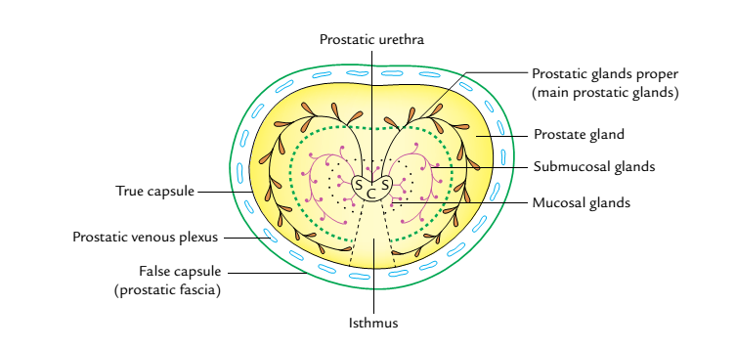
Horizontal section of the prostate gland showing its structural zones. Note mucosal,
submucosal, and main prostatic glands arranged into three concentric layers
(S = prostatic sinus, C = colliculus seminalis (urethral crest).

Slide 23
Blood supply
Arterial supply
The prostate gland is supplied by the branches of inferior vesical, middle rectal, and internal pudendal arteries.
Venous drainage
The veins from the prostate form a rich venous plexus around the sides and base of the gland and occupy the space between the true and false capsules. It receives the deep dorsal vein of the penis in front and is continuous above with the vesical venous plexus.

Slide 24
Cont’d
The mode of venous drainage from the prostatic venous plexus follows two pathways:
Into internal iliac veins through the posterior ligaments of the urinary bladder.
Into internal and external vertebral venous plexus (of Batson) through veins passing through anterior sacral foramina. The communication between the vesical and vertebral venous plexuses is valveless.

Slide 25
Nerve supply
The prostate is supplied by the following nerves:
The sympathetic supply is provided by the superior hypogastric plexus. The preganglionic sympathetic fibres arise from L1 and L2 spinal segments.
The parasympathetic supply is provided by the pelvic splanchnic nerves which convey preganglionic fibres from S2, S3, S4 spinal segments.

Slide 26
Lymphatic drainage
The lymphatics from the prostate drain into the internal iliac, external iliac, and sacral groups of the lymph nodes.

Slide 27
Applied Anatomy
Benign prostatic hypertrophy (BPH): After 50 years of age, the prostate gland is enlarged due to hypertrophy of median lobe (hypertrophy of subcervical glands of Albarran) forming an adenoma. The BPH commonly involves the median lobe, which compresses the prostatic urethra and obstructs the urine flow. The enlargement of uvula vesicae due to enlarged median lobe results in the formation of postprostatic pouch of stagnant urine in the urinary bladder behind the internal urethral orifice.

Slide 28
Cont’d
The surgical removal of adenoma is called prostatectomy. The adenoma is enucleated, leaving behind both the capsules and the prostatic venous plexus between them. After prostatectomy, the patient becomes infecund because the mechanism of internal urethral sphincter is disturbed and semen enters into the urinary bladder during ejaculation.
There are several surgical approaches of prostatectomy, namely, suprapubic, retropubic, perineal, and transurethral.

Slide 29
Cont’d
Clinically, BPH presents as: (a) increased frequency of urination, (b) urgency of urination, (c) difficulty in starting and stopping urination, and (d) a sense of incomplete emptying of the urinary bladder.
Prostatic carcinoma: It usually occurs after the age of 50 years. The carcinoma is commonly found in the outer (peripheral) zone which usually involves the posterior lobe.

Slide 30
Cont’d
In a digital rectal examination (DRE) reveals irregular, hard, fixed prostate, and absence of median groove in its posterior surface. The serum levels of acid phosphatase and prostate specific antigen (PSA) are used in diagnosis and management of prostate cancer.
The metastasis of prostatic carcinoma commonly occurs in the lumbar vertebrae and pelvis.
Clinically, it presents as: pain in perineum, urinary obstruction, difficulty in urination.

Slide 31


